Slide 1



Prompt & Partner with AI
Sean Wong
2025/08/05

Slide 2


Contents
01
02
03
04
Prompt Craft
Capability Map
Live Duel
Iterate & Apply

Slide 3


01
Prompt Craft

Slide 4


AI Needs Crystal Directions
Clear Instructions
Four Levers for Better Prompts
Example Contrast
AI responds best to clear, detailed instructions. Think of prompts as directions for a teammate who only understands what you explicitly tell them. Specificity reduces misunderstandings and improves output quality.
Use specificity, context, goal, and format to craft effective prompts. These elements help AI deliver more accurate and useful results, tailored to your needs.
Compare a vague prompt like 'Write about space' with a specific one: 'Write a 150-word inspirational summary about why space exploration matters, written for high-school students.' The latter yields a more focused and useful output.

Slide 5


Context turns Questions into Answers
01
Importance of Context
Adding background information, constraints, and audience profiles to your prompts helps AI produce more relevant and usable outputs. Context guides AI to focus on the right details.
02
Practical Benefits
Extra context in prompts saves time by reducing the need for editing and clarifying. It ensures that AI-generated content fits the intended purpose and audience from the start.

Slide 6
02
Capability Map

Slide 7
Where AI Excels Today
Speed and Efficiency
AI processes large amounts of data faster than humans, making it ideal for tasks that require quick analysis and summarization, such as condensing research papers or datasets.
Pattern Recognition
AI excels at identifying hidden relationships in data, which is useful for tasks like fraud detection, medical imaging analysis, and predictive maintenance in various industries.
Brainstorming and Creativity
AI can generate multiple ideas quickly, making it a valuable tool for brainstorming sessions. It can also reformat content efficiently, helping to organize and present information in new ways.
Practical Applications
Leverage AI for tasks like summarizing reports, drafting emails, or cleaning datasets. Its speed and efficiency can significantly boost productivity in daily work.

Slide 8


Hard Limits to Remember
Non-Negotiable Gaps
AI lacks emotions, moral judgment, personal experience, and up-to-date knowledge. These limitations mean human oversight is essential for tasks requiring empathy, ethical decisions, or current information.

Slide 9
03
Live Duel

Slide 10


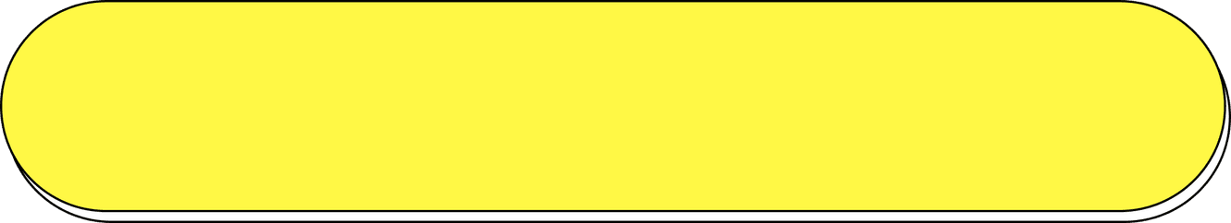

Vague Prompt Weak Output
Generic Request
A vague prompt like 'Write a story' yields generic, unfocused text. AI lacks direction and context, resulting in a lackluster output that requires significant revision.
Missing Elements
The output from a vague prompt often lacks detail, consistent tone, and relevance. This highlights the importance of providing clear instructions to get better results.

Slide 11

Rich Prompt Vivid Output
Practical Benefits
Detailed Instructions
Quality Improvement
Investing time in crafting clear prompts saves editing cycles and ensures that AI-generated content meets your needs from the first draft.
A rich prompt with audience, word count, theme, and style produces a tight, engaging narrative. AI can deliver high-quality output when given clear guidelines.
Compare the output from a vague prompt to a detailed one to see the dramatic difference. Specificity in prompts directly translates to better, more usable results.

Slide 12
04
Iterate & Apply

Slide 13





Refine Together in Loops
Iterative Refinement
Embedding Collaboration
Effective collaboration with AI involves iterative refinement. Critique the initial output, add new constraints, re-prompt, and blend human intuition with machine speed.
Embed iterative refinement as a habit to maximize the benefits of AI. This approach ensures continuous improvement and better outcomes.
Worked Example
Immediate Application
Show a practical example of polishing an article through three cycles. This demonstrates how iterative refinement improves quality and usability.
Apply iterative refinement in daily tasks like writing, coding, and analysis. This practice enhances productivity and ensures high-quality results.

Slide 14

Prompt Checklist for Daily Use
Portable Checklist
Immediate Practice Tool
A five-item checklist—goal, context, format, length, tone—fits on a sticky note and prevents 90% of weak outputs. Learners can use it to improve their AI interactions.
Photograph or copy the checklist for easy reference. Use it to enhance your AI partnerships across various tasks, ensuring better outcomes.

Slide 15

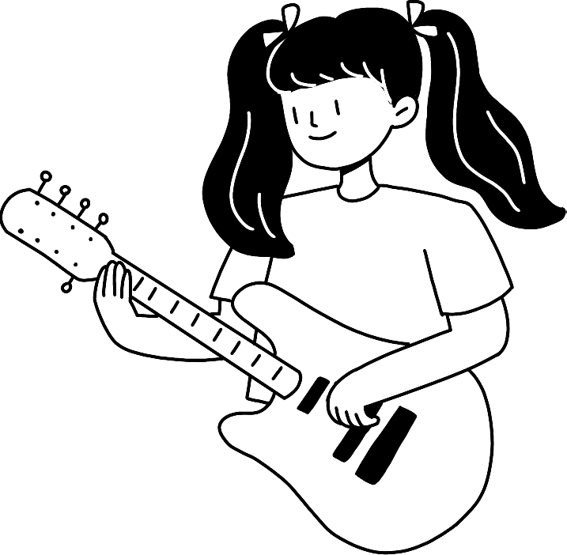
THANK YOU
Sean Wong
2025/08/05

